Slide 1

An Introduction to
Natural Language Processing
Massimo Piccardi
University of Technology Sydney, Australia
32931 TRM, Natural Language Processing module

Slide 2
Agenda
What is natural language processing?
An overview of NLP tasks
Document vectors
Word embeddings
Named-entity recognition
Topic modelling
Notes:
Definition
Overview
More in-depth view
Tutorial

Slide 3
Natural language processing (NLP)
A field at the crossroad of linguistics and machine learning, concerned with the analysis and synthesis of natural language
Has experienced a surge in popularity in recent years, becoming one of the most prominent areas of data science and finding applications in a number of fields, including online commerce, social media, healthcare, entertainment and many others

Slide 4
NLP: a quick overview
Research in NLP started as early as the 1950’s. A review is beyond the scope of our class, but a nice timeline can be found at: https://en.wikipedia.org/wiki/History_of_natural_language_processing
For many years, the approaches were based on linguistics, including language syntax, lexicon and morphology
Over time, statistical approaches and machine learning have become increasingly dominant – learn from data

Slide 5
NLP: a profusion of data
NLP data come from:
documents within an organisation
web pages
social media
publications, news, media transcripts
All languages (+ automated translations)
Speech-to-text (Siri, Alexa, Cortana etc)

Slide 6
Agenda
What is natural language processing?
An overview of NLP tasks
Document vectors
Word embeddings
Named-entity recognition
Topic modelling

Slide 7
NLP main tasks: an overview
NLP articulates over a large number of topical tasks, typically categorised from “low-level” (close to the syntax and lexicon) to “high-level” (close to the meaning)
We briefly describe some of these tasks over the next few slides

Slide 8
Some popular NLP tasks
Named-entity recognition
Sentiment analysis
Topic modelling
Summarization
Machine translation
Dialogue systems
NB: and many others: entailment recognition, relationship extraction, coreference resolution, wikification, …

Slide 9
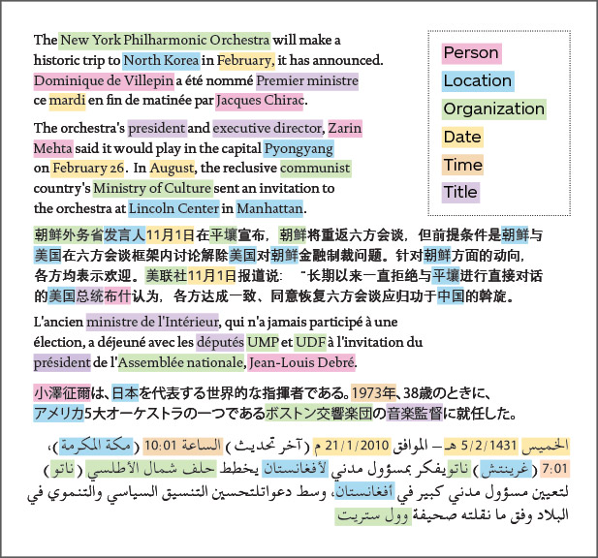
Named-entity recognition
Named-entity recognition (NER) aims to detect all the “named entities” in a given text. Typically, this includes people, locations, organisations and possibly others
REX (Rosette Entity Extractor, BASIS Technology)
Notes:
What can it be used for?
Highlight all entities so that they can be analysed automatically or reviewed by a human.
Often a step in higher-level tasks.

Slide 10
Sentiment analysis
Sentiment analysis aims to classify the “sentiment” of a given text (even a tweet or an email):
In the simplest form, this can be done by looking at specific keywords
In a more current approach, the text at hand is converted into a single vector (“document representation”) which is used with a conventional classifier to infer the class of the sentiment
“You should see their decadent dessert menu” → positive sentiment
Notes:
“Decadent” as a keyword may be negative, but the overall meaning here is positive
The keyword approach may also struggle with negations

Slide 11
Topic modelling
Topic modelling aims to identify the main topics of a given collection of documents − this provides an instant-view of its composition
Simultaneously, it also identifies the proportions of these topics in each document in the collection
The topic proportions can be used to automatically categorise/classify/cluster the individual documents and organise the collection
Notes:
Topic modelling is a “workhorse” of NLP

Slide 12
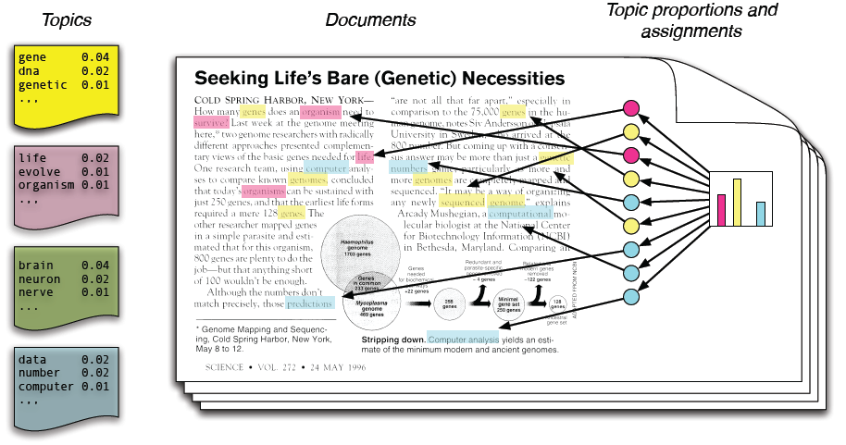
Topic modelling
from D. Blei, “Probabilistic Topic Models”, Communications of the ACM, 55(4):77-84, 2012

Slide 13
Summarisation
Example of extractive text summarisation from Salesforce (courtesy of Frase.io)
Abstractive summarisation generates a whole new text

Slide 14
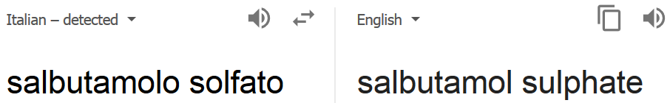
Machine translation
Machine translation is one of the most successful applications of NLP
Since language pairs are many, a pivot language may be used (e.g. Filipino → Eng, Eng → Catalan)
Google Translate nowadays can translate to/from 109 languages. It crawls the web and learns to translate from pages that are likely translations

Slide 15
Dialogue systems
Dialogue systems are likely the most complex NLP technology on the horizon
Two main types:
task-oriented dialogue systems: short, targeted conversations to extract extra info from a user to complete a task
chatbots: extended, engaging human-like conversations
They include question-answering systems: “Who was the king of Spain in 1492?”; “What is the product of two and 3.5?”
Notes:
Try the second question in Google Search

Slide 16
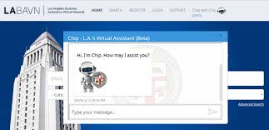
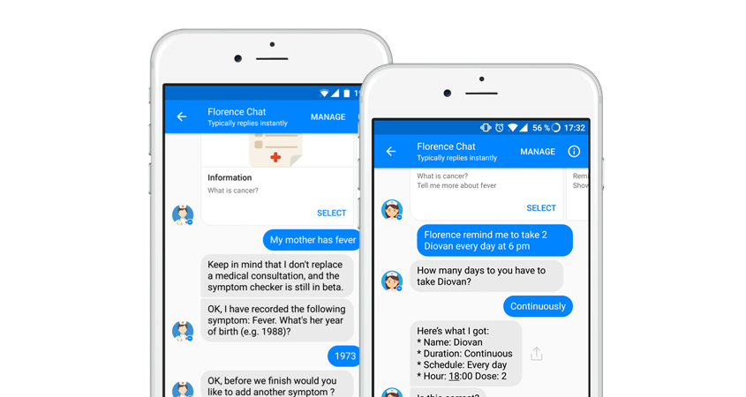
Dialogue systems
Many benefits to user and customer interaction
Los Angeles Chip is “an anytime, anywhere resource to understand how to do business with the city” (Los Angeles CIO Ted Ross)
Florence is a health tracker
and medication reminder

Slide 17
Agenda
What is natural language processing?
An overview of NLP tasks
Document vectors
Word embeddings
Named-entity recognition
Topic modelling

Slide 18
Document vectors
A document vector is a numerical vector representing a whole document for various purposes
Given a vocabulary of size V, a basic document vector is obtained by counting how often each word in the vocabulary appears in the document:
The above is called term frequency (tf) and it is a histogram with V bins; often, it is normalized (by dividing it) by the length of the document
20
10
dog
leash
walk
…
…
…
(V)
aardvark

Slide 19
Document vectors
The world economy or global economy is the economy of the humans of the world, considered as the international exchange of goods and services that is expressed in monetary units of
…
aardvark = 0
…
economy = 26
…
global = 8
…
of = 44
…
the = 85
…
world = 12
…

Slide 20
tf-idf
Unfortunately, the term frequencies tend to be dominated by uninformative words such as “and”, “to”, “I” etc. It is desirable to reweigh the term frequencies to discount them
Given a document collection, the inverse document frequency of a word is a coefficient that accounts for in how many documents the word appears (the fewer, the better)
tf-idf is the term’s frequency multiplied (i.e., weighed) by its inverse document frequency
Notes:
Some of these words can be removed by a preprocessing step (i.e., we know a priori that they are not informative), but it would still be better to have an appropriate weighting mechanism

Slide 21
Example
In Shakespeare’s plays, the most frequent word is the word “the” which appears 28,944 times¹
However, since it appears in all the plays, its idf value is zero!
The words with the highest tf-idf identify the protagonist of each play²:
THE TAMING OF THE SHREW: petruchio (633.05)
THE TEMPEST: prospero (527.44)
KING LEAR: lear (847.55)
MACBETH: macbeth (1058.53)
…
http://www.opensourceshakespeare.org/stats/
http://www.philadelphia-reflections.com/blog/2792.htm

Slide 22

Document classification with tf-idf
tf-idf extraction
classifier
extracted tf-idf
text from a phone call with an insurance client
“won’t return to work”
“will return to work”

Slide 23
Agenda
What is natural language processing?
An overview of NLP tasks
Document vectors
Word embeddings
Named-entity recognition
Topic modelling

Slide 24
Words as categorical values
In the first place, words are strings of text and they can be manipulated as such (e.g., regexes)
However, words such as “cat” and “car” have little in common and similarities change with the language
An alternative is to ignore the strings altogether and treat words as categorical values in a vocabulary
However, the size of typical vocabularies (50,000-100,000, and 5ML for the UMLS Metathesaurus) is much larger than usual category sets

Slide 25
Word representations
An alternative is to represent a word by some representative “features” (“is the word capitalised?”, “does it end with s?”, “does it contain digits?”, “how long is it?” etc)
Such features can be sufficiently informative for some NLP tasks
However, the current trend is to convert each word to a numerical vector (distributional word representations aka word embeddings)

Slide 26
Word embeddings
The conversion of words to vectors is most often referred to as word embedding
It maps each word to a point in a typically high-dimensional (100-500D) vector space
The expectation on this mapping is that semantically-similar words will be close to each other in the vector space

Slide 27
A toy example
A toy example (vector space simplified to 2D):
car
wolf
truck
dog
cat

Slide 28
Word embeddings: learning
Word embeddings can be learned from large collections of unannotated text such as Wikipedia or Common Crawl
The principle is to look at the frequencies of the words surrounding the given word - often called the context (example in the next slide)
Popular embeddings: GloVe (Stanford), Word2vec (Google), fastText (Facebook)

Slide 29
Example
cf. trees and pines:
“Everything - even mountains, rivers, plants and trees - should be your teacher.”
(Morihei Ueshiba, The Art of Peace)
“lies between two immense mountains covered with pines and snow.”
(Richard H. Davis, Adventures and Letters)

Slide 30
Cooccurrence matrix: a toy example
For each word, the counts of its surrounding words form the co-occurrence matrix
An example courtesy of Richard Socher’s CS224d course at Stanford (window size of 1 in both directions):

Slide 31
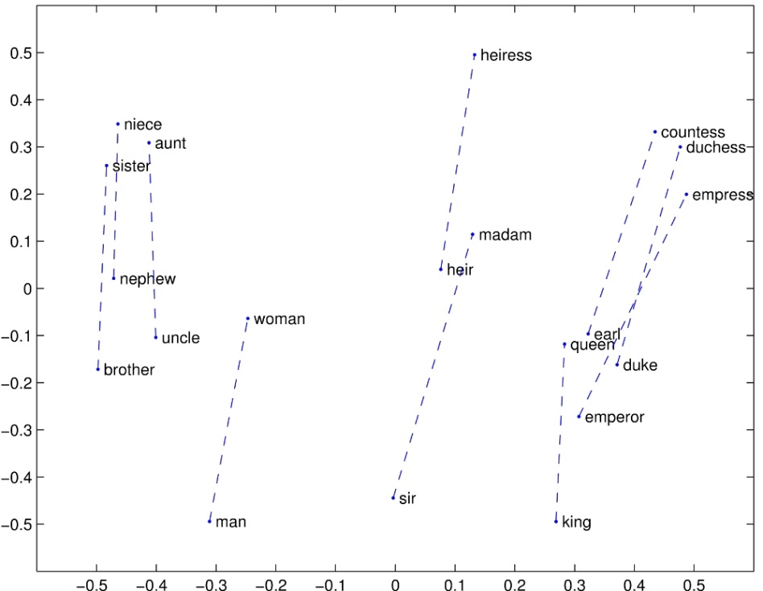
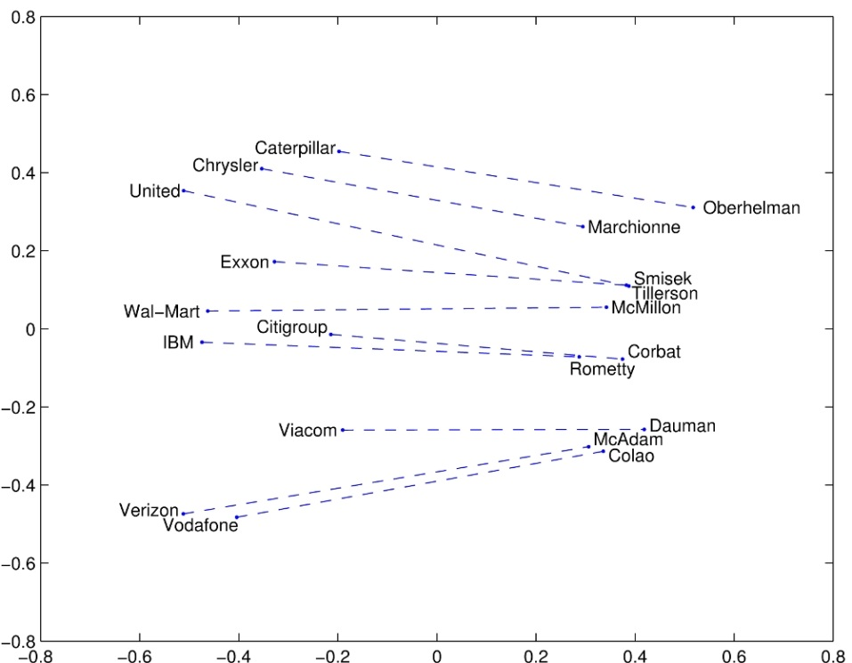
Word embeddings retain semantics
“man” - “woman”
“company” - “ceo”
(source: GloVe https://nlp.stanford.edu/projects/glove/)
Notes:
What are word embeddings useful for? We’ll see an example in the next few slides.

Slide 32
Fine-tuning word embeddings
Word embeddings can be learned in an unsupervised manner from large amounts of text
If they are used as the input to a supervised task, they can alternatively be learned from the minimisation of the task training objective (via backpropagation)
Since the training objective is typically not convex (i.e., the minimum is local and depends on the initialisation), the "best of both worlds" is typically to pre-train the word embeddings in an unsupervised way, and then fine-tune them based on the training objective

Slide 33
Fine-tuning word embeddings
loss function Δ(y_{i}, f(w_{i}))
predictor/classifier
w_{i} (embedding)
"cat" (word as a string)

Slide 34
Contextual word embeddings
Traditional word embeddings such as GloVe and word2vec map each distinct word in a vocabulary to a unique numerical vector (the embedding)
This means that the word embedding is the same no matter where the word is encountered (i.e., its context)
Contextual word embeddings instead map each instance of a word to its own numerical vector. In this way, they can also embed its specific context

Slide 35
Contextual word embeddings
Contextual word embeddings have surged to fame in recent years (2016-) because they have improved virtually every NLP task
BERT most likely the most popular (and ELMo, GPT-2, Flair etc); DistilBERT popular for leaner systems
They are typically first trained in an unsupervised manner to predict the next, the previous or masked words in a text (a so-called language model), and then fine-tuned for the task

Slide 36
Agenda
What is natural language processing?
An overview of NLP tasks
Document vectors
Word embeddings
Named-entity recognition
Topic modelling

Slide 37
Named-entity recognition
A named entity in a text is an entity with a specific name such as a person, a location, an event and so on
The current trend is to tackle named-entity recognition (NER) as classification of individual words. Each word has to be assigned to the correct segmentation prefix (Begin, Inside and Outside) and class (aka “type”). Example:
We | visited | Lemington | Spa | and | Stratford-upon-Avon
Outside | Outside | B-Location | I-Location | Outside | B-Location

Slide 38
NER: approaches
Q: Isn’t it possible to simply collect and store all the named entities for a given language? (this is called a gazetteer in NLP jargon)
A: They are too many (for instance, millions in medical domains) and may change over time (new person names, new drugs etc)
→ some generalisation to unseen cases is required in all cases

Slide 39
NER: approaches
In alternative, one can derive a set of handcrafted rules
For instance: if a word
1) starts with an uppercase letter, and
2) ends with “ol”, it is likely a drug name (examples: Paracetamol, Metoprolol, Albuterol etc)
Exception: Bristol! (both a city and a county in the UK)
Misspellings, abbreviations, variants…: rule-based approaches are difficult to scale

Slide 40
A more modern approach
A more modern approach for NER is to convert each individual word to a feature vector, and then pass the feature vector to a classifier to obtain the word’s label:
feature vector for word XYZ
(e.g., Paris)
label for word XYZ
(e.g., B-LOC)
classifier
Notes:
Word XYZ might not have been seen in the training set.
It might even be missing from our embeddings and therefore be assigned an “unk” value (e.g, 0 or random).
However, thanks to the other words, if we’re lucky the concatenated vector may still fall in the right classification region (B-LOC).
The MUC-7 and CoNLL scores are both variants of the F1 score, but computed at entity rather than token level.

Slide 41
A more modern approach
Features:
first, convert each word to its embedding; say, w
then, concatenate the word’s embedding and those of a few words before and after:
[w_{t-2} w_{t-1} w_{t} w_{t+1} w_{t+2}]
In this way, if unseen word XYZ is met in a sentence such as “I visited XYZ last year” may be correctly classified as B-Location even if it was never encountered in the training set
Use a good classifier: SVM, CRF, RNNs…
Notes:
Word XYZ might not have been seen in the training set, but did you visit a fridge last year?
It might even be missing from our embeddings and therefore be assigned an “unk” value (e.g, 0 or random).
However, thanks to the other words, if we’re lucky the concatenated vector may still fall in the right classification region (B-LOC).
The MUC-7 and CoNLL scores are both variants of the F1 score, but computed at entity rather than token level.

Slide 42
Contemporary approaches
Contemporary approaches to NER are all based on deep recurrent neural networks such as LSTMs and Transformers
While they are typically trained end-to-end (from the words still coded as strings all the way up to the NER labels), good contextualised word embedding still play a major role in the performance
Have a look at the leaderboard at: http://nlpprogress.com/english/named_entity_recognition.html
Notes:
Word XYZ might not have been seen in the training set, but did you visit a fridge last year?
It might even be missing from our embeddings and therefore be assigned an “unk” value (e.g, 0 or random).
However, thanks to the other words, if we’re lucky the concatenated vector may still fall in the right classification region (B-LOC).
The MUC-7 and CoNLL scores are both variants of the F1 score, but computed at entity rather than token level.

Slide 43
Agenda
What is natural language processing?
An overview of NLP tasks
Document vectors
Word embeddings
Named-entity recognition
Topic modelling

Slide 44
Topic modelling
Preamble:
We are given a (possibly large) collection of documents
The term frequencies or the tf-idf values of each document are computed
For D documents and a vocabulary of size V, they form a large D x V matrix (the term-document matrix)

Slide 45
The term-document matrix
D columns
(number of documents in the collection)
V rows
(number of words in the vocabulary)
word counts of document #1

Slide 46
Topic modelling
Is it possible to identify a set of shared topics in the document collection (T ≪ D)?
A topic is nothing else than a specific frequency distribution over the vocabulary
for instance, for topic “cricket”, words such as “stumps”, “wicket”, “lbw” etc would have high frequencies, but nearly zero in other topics;
note that the word→topic correspondence is not trivial since words such as “bye”, “bat”, “bail”, “over” etc would have possibly high frequencies in multiple topics

Slide 47
Topic modelling as matrix factorisation
D
T
D
V
term-document
=
V
term-topic
x
T
topic-document

Slide 48
Topic modelling: a schematic
Given a document collection, break it down into the term-topic and topic-document matrices
The term-topic matrix gives you an idea of the overall collection
Each topic-document vector gives you an idea of the individual document and can be used as a feature vector to classify the document

Slide 49
Example: classification based on topics
topic modelling
classifier
extracted topics
text from a phone call with an insurance client
“won’t return to work”
“will return to work”

Slide 50
Topic models
The model we have described is called latent semantic indexing (Hoffmann, 1999)
Latent Dirichlet allocation (LDA) adds a probabilistic modelling which brings a number of advantages; almost universally used
Available in popular packages such as scikit-learn, gensim etc; e.g.:
from sklearn.decomposition import LatentDirichletAllocation
...
lda = LatentDirichletAllocation(n_components=...)
lda.fit(...)
The number of topics is typically chosen with heuristics

Slide 51
How to become an NLP developer ☺
Learn fundamentals of NLP and machine learning
Learn Python, including NumPy and pandas
Learn traditional NLP libraries such as NLTK and Gensim
Step up to a deep learning environment: PyTorch/Lightning, TensorFlow/Keras
Learn all the tools of this trade, including AWS etc

Slide 52
Summary
NLP is one of the most prominent components of the current AI “revolution”
It addresses many, diverse tasks all the way up from simple text tagging to chatbots
It is increasingly exploiting machine learning and the burgeoning amount of digital language resources
Pervasive application in many fields

Slide 53
Some useful references
Chris Manning, CS224n Natural Language Processing with Deep Learning, Stanford University
possibly THE NLP online course
S. Bird, E. Klein, and E. Loper, Natural Language Toolkit https://www.nltk.org/index.html, http://www.nltk.org/book/
a famous library for building NLP programs in Python
D. Jurafsky, J. Martin, Dialog Systems and Chatbots, Speech and Language Processing, third edition draft, 2017
Various authors, Google's Neural Machine Translation System: Bridging the Gap between Human and Machine Translation, arXiv, 2016
V. Yadav, S. Bethard, A Survey on Recent Advances in Named Entity Recognition from Deep Learning Models, COLING 2018: 2145-2158
D. M. Blei, A. Y. Ng, M. I. Jordan, Latent Dirichlet Allocation, JMLR 2003

Slide 54
Thank you all
Thank you all very much for listening!
I hope this lecture will provide you with a good guidance for your first steps in NLP
Please feel free to ask me questions and I will do my best to reply promptly:
Massimo Piccardi
<Massimo.Piccardi@uts.edu.au>

